Slide 1
NLP BBC Project
George Antonakis · Samuel Cook · Orestis Pappas

Slide 2
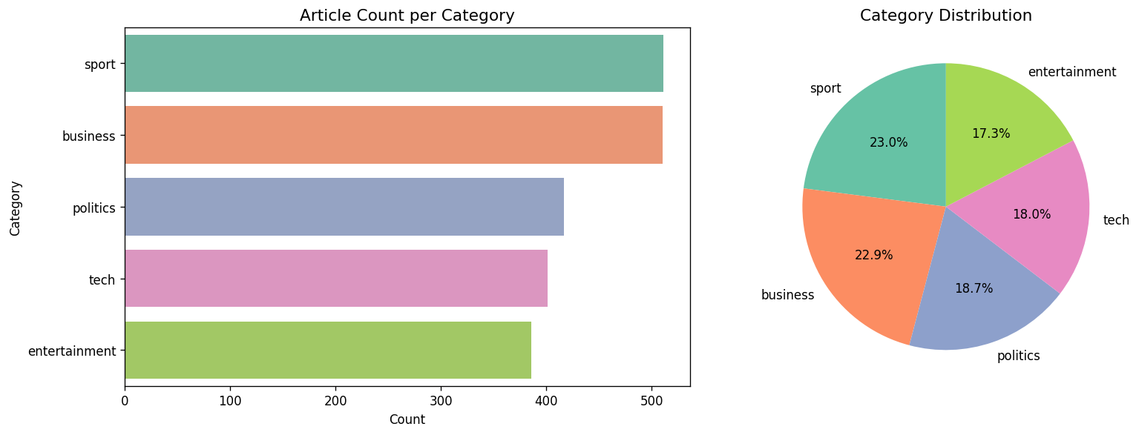
What is our project
end-to-end NLP pipeline built on the BBC News dataset
2,225 news articles from 2004 and 2005
five categories: business, entertainment, politics, sport, and tech.
The data comes from HuggingFace's
The categories are reasonably balanced — sport and business are the largest, tech and entertainment slightly smaller, but no category dominates.

Slide 3
Preprocessing
We built a standard text-normalisation pipeline
Lowercase
Strip URLs and HTML tags
Expand contractions
Remove punctuation
Remove stopwords
Lemmatise
We chose lemmatisation over stemming deliberately: stemming can mangle words into non-words, which hurts readability of everything downstream, especially our topic model's keyword lists and our word-embedding neighbours.
Checked for missing values
99 duplicate or near-duplicate articles
That left 2,126 articles
Kept two versions of the text throughout the whole project, the original raw text, and this cleaned version.
Our from-scratch models want the cleaned version, but our pretrained transformer model, DistilBERT, performs better on the original, uncleaned text, because it has its own subword tokenizer that already knows how to handle punctuation and capitalisation.

Slide 4
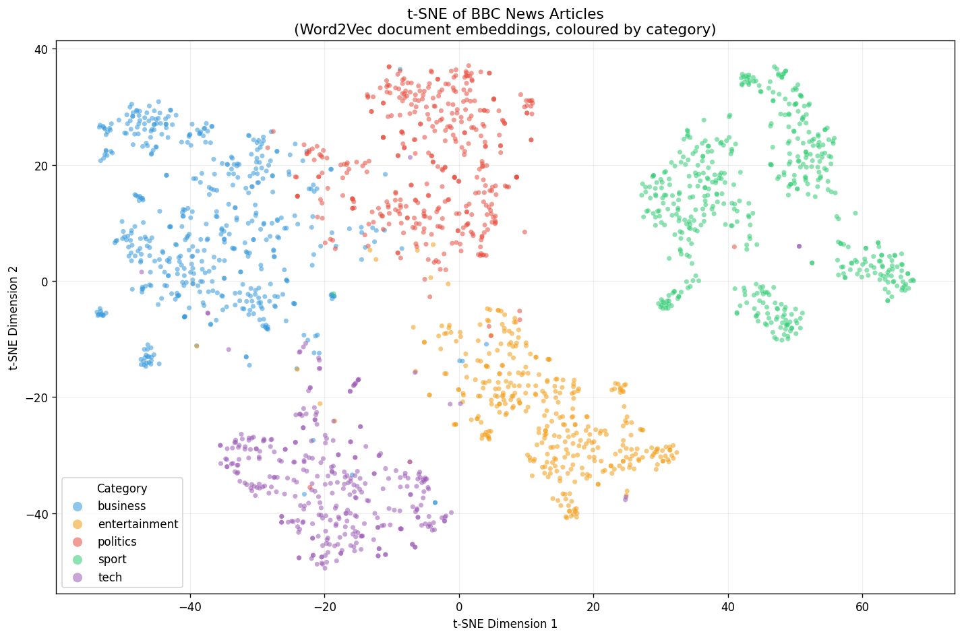
Feature Engineering
To visualise the embedding space, we projected our 100-dimensional Word2Vec document vectors down to 2D using t-SNE, coloured by category
Built three feature representations
A TF-IDF matrix
Word2Vec model
Trained from scratch on our own corpus
Averaged Word2Vec vectors
As one deliverable, we built a function that takes any word and returns its most similar words by embedding distance.

Slide 5
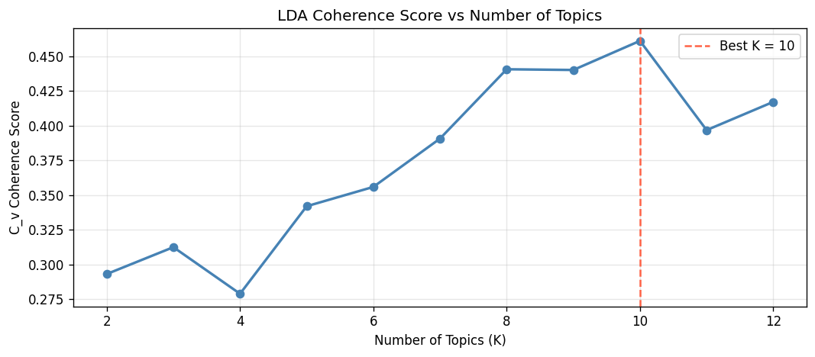
Topic Modelling (Unsupervised)
Double our number of known categories.
LDA split several of our categories into finer sub-themes.
That's not a failure — it's the unsupervised method finding real structure inside our categories that the human labels don't capture.
For unsupervised learning, we used Latent Dirichlet Allocation (LDA)
We trained models for every K from 2 to 12 and scored each using coherence
Found K equals 10 gave the best score.

Slide 6
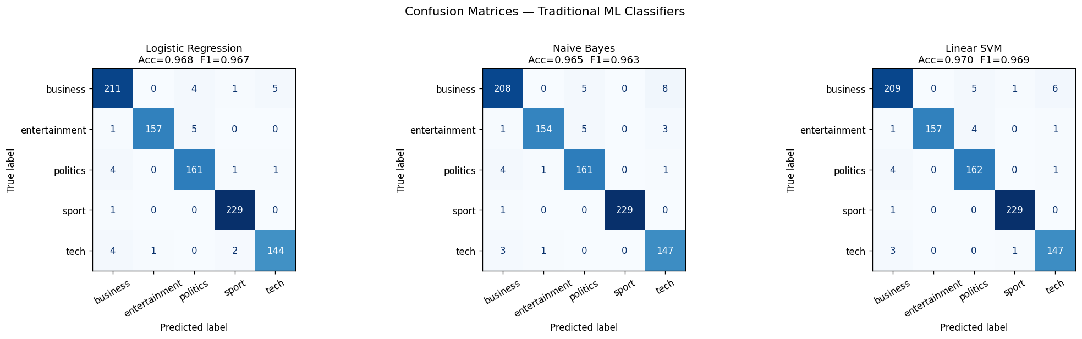
Topic Modelling (Supervised)
We trained three classical models on TF-IDF features
Logistic Regression,
Naive Bayes,
linear Support Vector Machine
TF-IDF on the training data only, to avoid any information leaking from the test set.
All three performed extremely well — between 96.5% and 97% accuracy.
Linear SVM was the best of the three, at 97.0% accuracy and 0.969 macro F1.

Slide 7
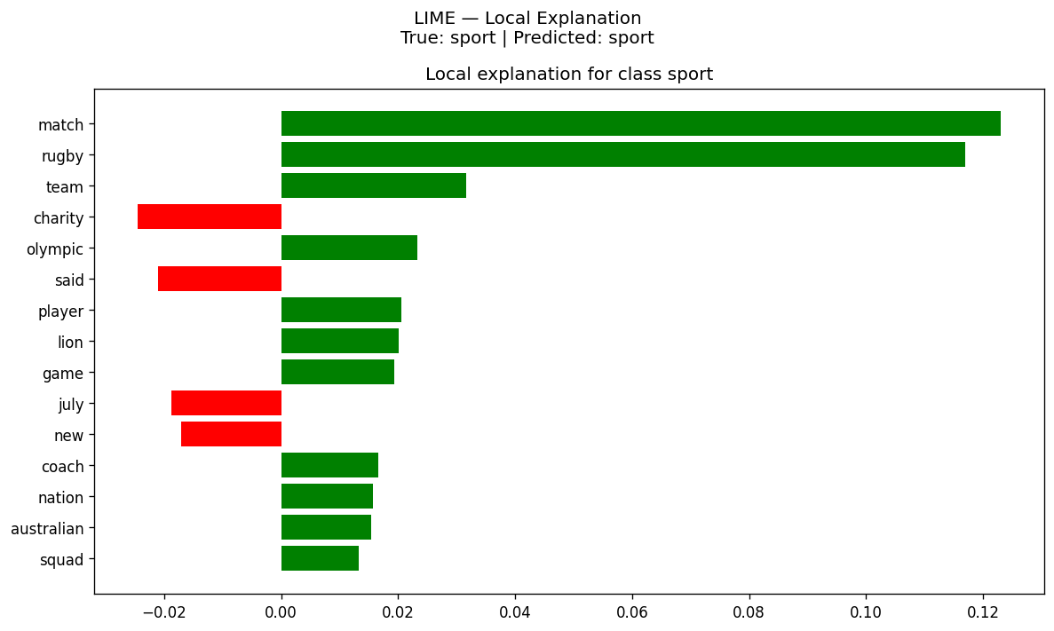
Explainability
Local Interpretable Model-agnostic Explanations (LIME)
Explains one prediction at a time by showing which words pushed the model toward its answer.
LIME highlights the specific words that drove the sport prediction.
We also looked at a misclassified example to understand where the model gets confused.
Giving us both a local and a global view of what the model has learned.

Slide 8
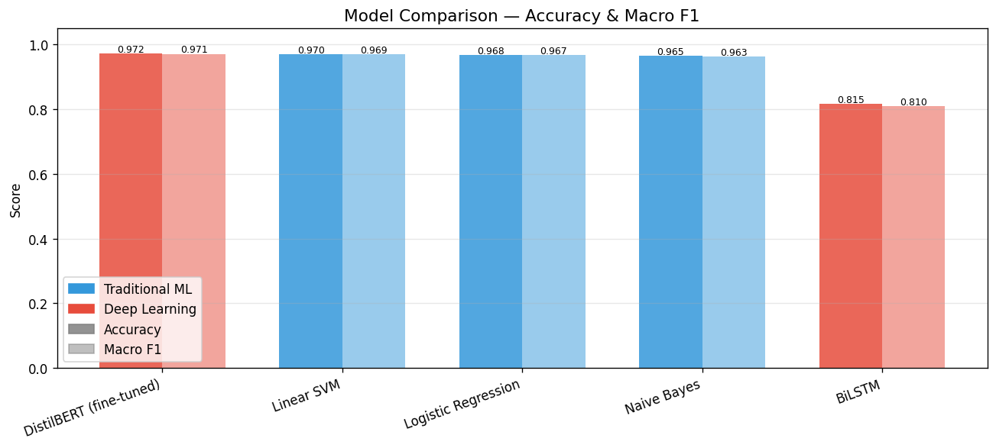
Deep Learning
DISTILBERT
Bidirectional LSTM
Then we fine-tuned DistilBERT
a compressed, pretrained transformer
This reached 97.2% accuracy and 0.971 macro F1
Bidirectional LSTM
No pretrained embeddings
'From scratch' deep learning model compares to classical machine learning.
It reached 81.6% accuracy
Beaten by Naive Bayes, the simplest model we tried.

Slide 9
Deep Learning Continued
Our two deep learning models are at opposite ends?
DistilBERT at 97.2%, the LSTM at 81.6%.
Meanwhile DistilBERT and a bag-of-words SVM differ by 0.2.
DistilBERT starts from representations learned on billions of words and only has to learn the mapping onto five labels.
The LSTM starts from random noise and has to learn what words mean and how to classify
The margin matters.
DistilBERT beats our Linear SVM by 0.21 percentage points
On a test set of 932 articles, that's a difference of two articles.
The honest reading is that a 67-million-parameter transformer and a linear model over word counts are tied.
Transformers advantage is understanding context and word sense
BBC categories are so lexically distinct that the word 'shares' or the word 'scored' basically settles the answer on its own

Slide 10
RAG
Retrieval-Augmented Generation system a chatbot that answers questions grounded in our article corpus, rather than making things up.
Two parts:
A Retriever
A Generator
We evaluated it on ten manually written questions about topics from the corpus.
Scoring the generated answers against expected answers with ROUGE-L
Our mean was 0.155, with a best of 0.31 and two questions scoring zero.

Slide 11
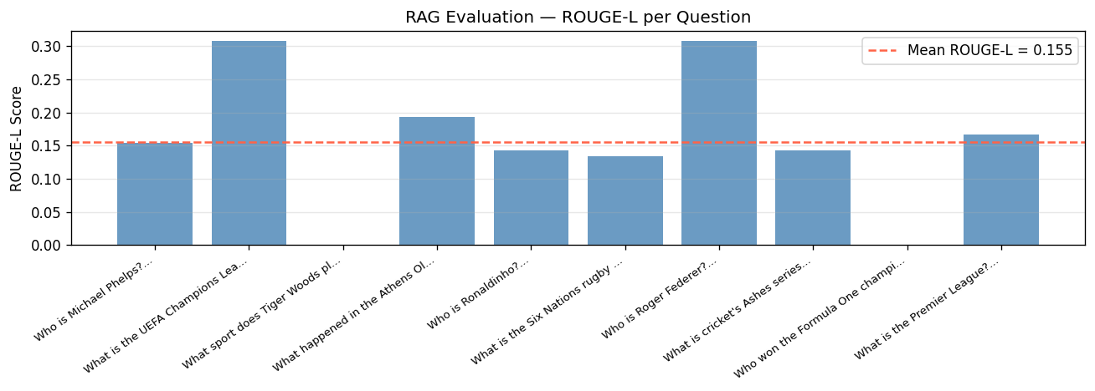

Slide 12
RAG Continued
ROUGE-L scores the longest common subsequence against a reference answer — it rewards wording overlap
Instance 1
Instance 2
Our reference for 'What sport does Tiger Woods play?' was the full sentence 'Tiger Woods is a professional golfer.' But an instruction-tuned model asked a direct question answers tersely — it says 'golf'. That answer is completely correct, and it scores exactly zero, because 'golf' and 'golfer' are different tokens with no common subsequence. Both of our zero-scoring questions are short-factoid questions of exactly that shape.
We can check retrieval separately, and retrieval is sound. When we query 'Who won the football championship?', it returns two relevant football articles — and a review of the video game Championship Manager, tagged tech. That third hit isn't a bug; it's evidence the retriever is matching on meaning rather than keywords, because it understood 'championship' in a sense our query never disambiguated.
Flan-T5-base is small, so its answers are terse
some of our own questions aren't answerable from this corpus
What we should have done is measure retrieval and generation separately
Recall@k for the retriever — and score answers with something like BERTScore that credits correct paraphrases.

Slide 13
Streamlit
TAB 1
Where you paste any news text and get a live category prediction with confidence scores.
Tab 2
Where you can ask the RAG chatbot a question and see both its answer and the source articles it retrieved.
(Start Hopeful Live demonstration here)

Slide 14
Conclusion
Built a complete pipeline from raw text to a deployed, working chatbot.
Unsupervised topic discovery, three classical classifiers, two deep learning approaches, an explainability layer, and a retrieval-based question-answering system.
Pre-training, not depth, is what separates these models
The best model on the leaderboard isn't always the right model to ship.
Future work
The cleanest next experiment is to initialise that same LSTM from pretrained GloVe or FastText embeddings
We'd also rebuild the RAG evaluation to measure retrieval and generation separately, and test our 'no headroom' explanation on a harder corpus — something like sarcasm or fine-grained sentiment.

Slide 15
Thank You
Questions?

